Slide 1
Improving crop production using an agro-deep learning framework in precision agriculture
01

Slide 2
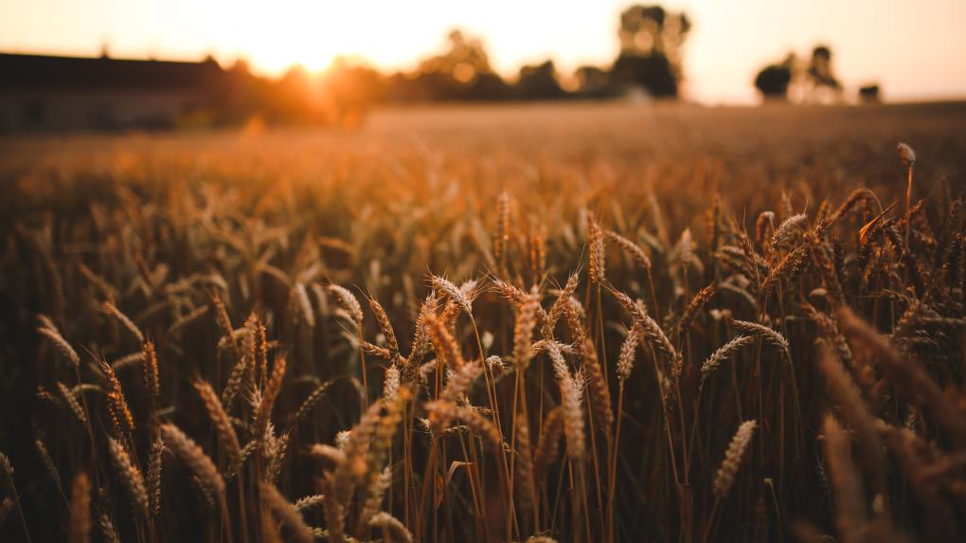
Core Idea
In order to increase the precision of crop yield prediction and yield classification, the main goal of this project is to create an Agro Deep Learning Framework (ADLF) that incorporates multi-source agricultural data, such as environmental, soil, weather, satellite, and image-based information.
The intricate relationships between various agricultural factors are frequently missed by traditional machine learning models, which frequently rely on a single type of data (such as environmental or tabular features).
By creating a multi-input convolutional neural network (CNN) with specialised branches that can learn from diverse inputs, this project overcomes that constraint. Different data sources are processed by each branch, and Dense-Inception layers, Spatial Pyramid Pooling (SPP), and Attention mechanisms are used to fuse the features that have been extracted.
The framework's ability to gather varied data from various sources is made possible by its design, which offers a more comprehensive understanding of the variables affecting yield.
In order to help farmers and policymakers maximise crop productivity and resource use, the ultimate goal is to enable data-driven decision support in precision agriculture.

Slide 3
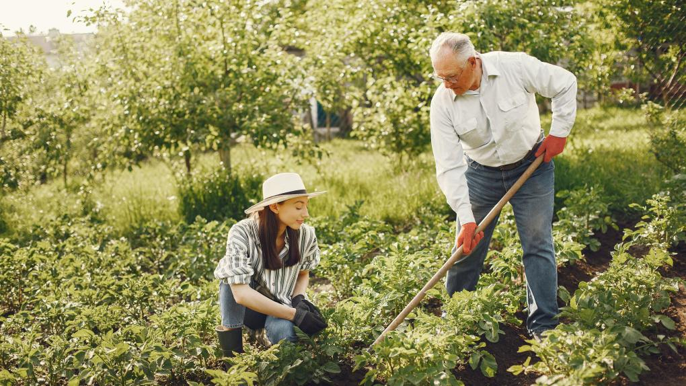
Introduction and Problem Definition
Agriculture is essential to rural livelihood and food security. However, a number of factors, including erratic weather patterns, fluctuations in soil fertility, sporadic rainfall, and restricted access to real-time data-driven insights, significantly impact crop productivity in many regions.
Because it facilitates effective decision-making in crop planning, irrigation scheduling, and resource management, accurate crop yield prediction has thus emerged as a critical challenge in contemporary precision agriculture.
Using separate data sources, such as soil or weather data, traditional statistical and machine learning techniques, like linear regression, Random Forest, and SVM, have demonstrated some success in modelling yield patterns.
These models are constrained, though, in three ways:
1. they are unable to capture the non-linear interactions between various agricultural factors;
2. they are unable to integrate data from multiple sources (such as soil, weather, satellite, and crop features); and
3. they are not scalable when working with high-dimensional or image-based agricultural datasets.
This mini project suggests an Agro Deep Learning Framework (ADLF) built on a multi-input convolutional neural network (CNN) architecture in order to get around these restrictions.
NDVI-based satellite indices, weather and soil parameters, tabular environmental features, and optionally image data are among the various forms of agricultural data that the framework is intended to process and combine into a single model.
The framework plans to enhance the generalisation and dependability of yield classification and yield prediction by combining these various data sources, ultimately supporting data-driven precision agriculture and sustainable farming methods.
03

Slide 4
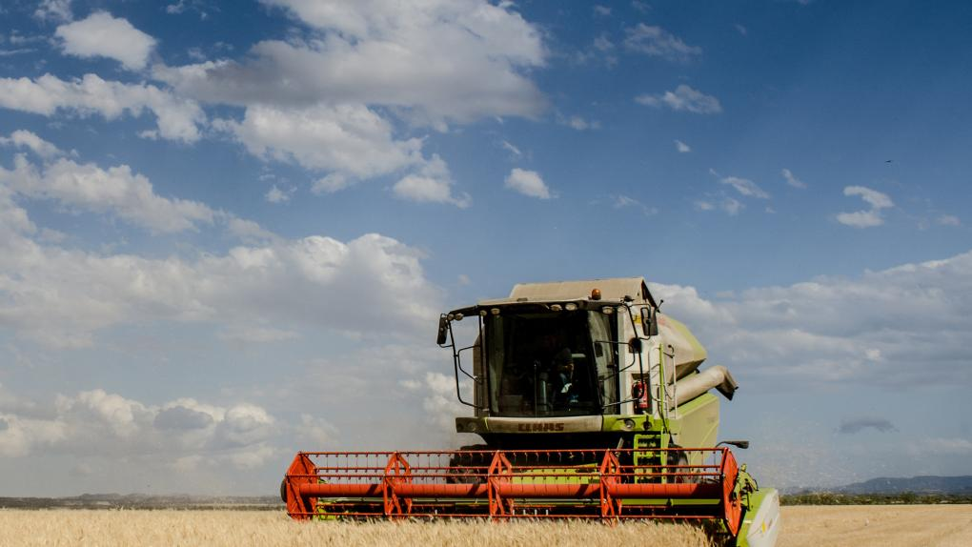
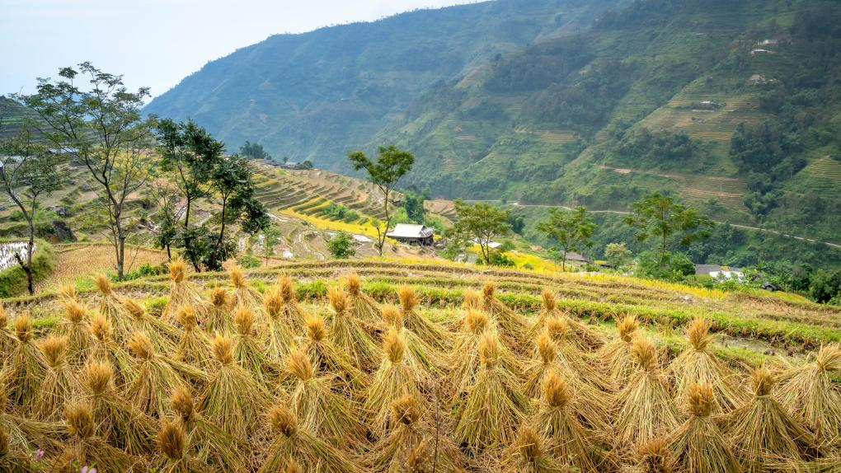
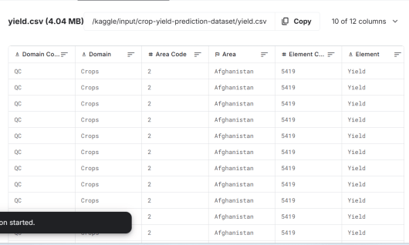
About Dataset
Area wise environmental and agronomic variables are included in the Crop Yield Prediction Dataset (yield.csv) from Kaggle.
Important characteristics include:
Weather characteristics: precipitation, humidity, and temperature
Features of the soil: pH, moisture content
Features of the satellite: Normalised Difference Vegetation Index (NDVI)
Crop feature: crop type or category
The variables of interest are yield class (classification) and crop yield (regression).
StandardScaler was used to normalise all features, and one-hot encoding was used for categorical variables (crop type).
Using stratified sampling, the dataset was divided into 80% training and 20% testing.
04

Slide 5
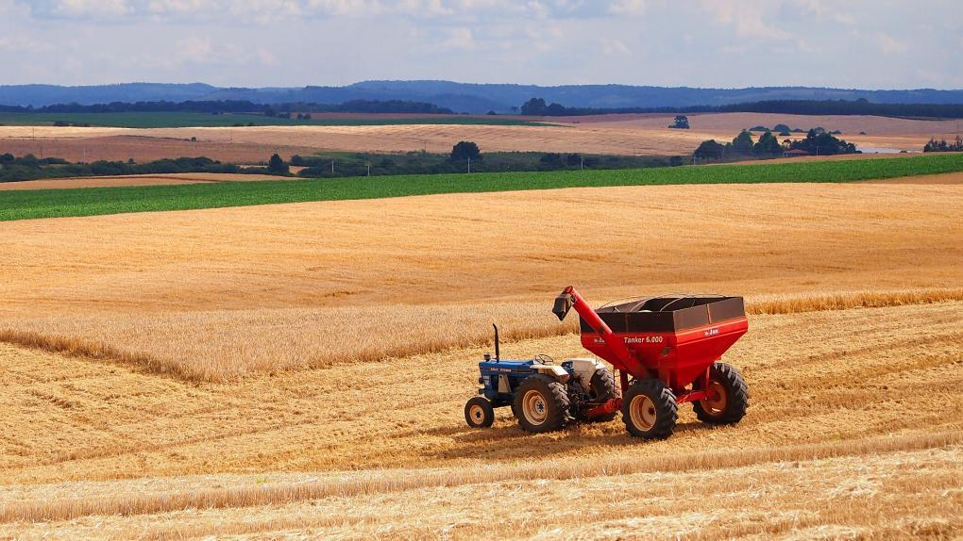
Objectives
Develop a multi-branch deep neural network that integrates image and tabular inputs (weather, soil, satellite indices, crop type).
Implement advanced modules such as Dense-Inception blocks, Spatial Pyramid Pooling, and Attention mechanisms for multi-scale feature extraction.
Evaluate the model against traditional baselines (Random Forest, SVM) using metrics such as Accuracy, Precision, Recall, and F1-score.
Achieve stable and reproducible performance close to the original ADLF research benchmark (80–90% accuracy).
05

Slide 6
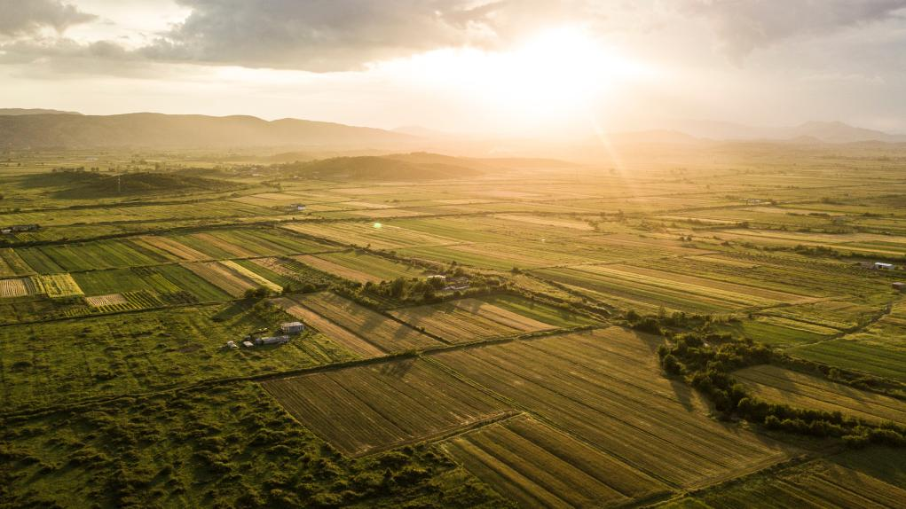
CNN-Based ADLF Architecture
The proposed ADLF model is built using the Keras Functional API, comprising six parallel input branches:
Image Input (64×64×3): processed through Dense-Inception blocks and Spatial Pyramid Pooling to extract spatial patterns.
Tabular Input: fully connected layers handling general environmental and climatic variables.
Weather Input: learns temporal-climate dependencies through dense layers.
Soil Input: encodes soil chemistry and moisture patterns.
Satellite Input: focuses on NDVI-based vegetation health indices.
Crop Input: categorical embedding representing crop type.
These branches are concatenated into a fusion layer, followed by:
  Channel and Spatial Attention (CnSAU) modules for feature refinement.
  Dual output heads:
    Regression head – predicts numerical yield.
    Classification head – predicts yield category (low, medium, high).
Optimization used Adam optimizer, categorical cross-entropy (classification), and MAE (regression) losses with combined weighting.
Training employed callbacks: EarlyStopping, ReduceLROnPlateau, and ModelCheckpoint.
04

Slide 7
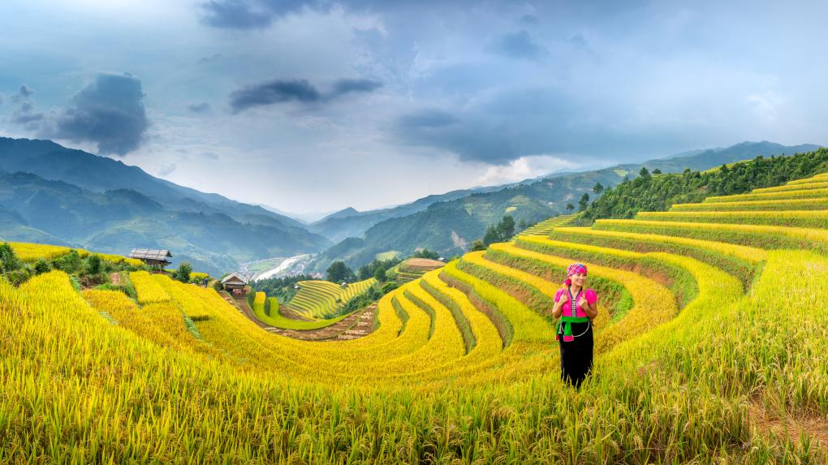
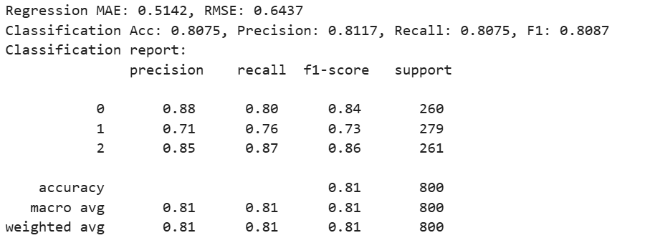
Results and Performance
After deterministic evaluation, the ADLF model achieved the following metrics on the test split:
09

Slide 8
Thank You

